Slide 1
Digital Images
Google Classroom Code
p6go7q

Slide 2
What is an Image?
Image is a two dimensional light-intensity function, f(x,y), where the value of f at a spatial location (x,y) is the intensity of the image at that point.
When x, y and amplitude values of f are all finite, discrete quantities, it is called a digital image.

Slide 3
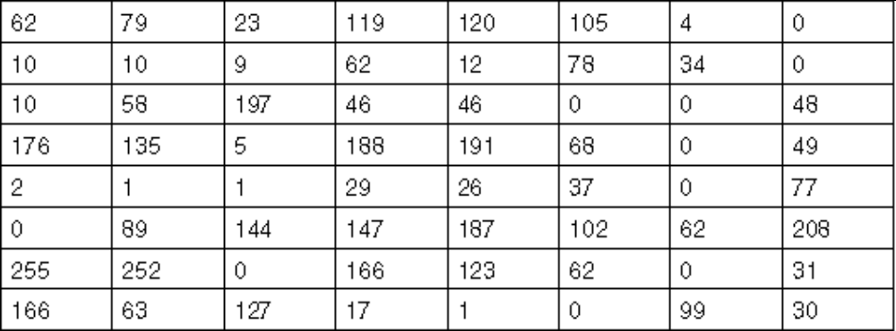
Digital Images
We usually operate on digital (discrete) images:
  Sample the 2D space on a regular grid
  Quantize each sample (round to nearest integer)
If our samples are ∆ apart, we can write this as:
f[i ,j] = Quantize{ f(i ∆, j ∆ ) }
The image can now be represented as a matrix of integer values

Slide 4

Image Formation

Slide 5

Sampling and Quantization

Slide 6

Sampling and Quantization

Slide 7
Simple Image Formation Model
For an image generated from a physical process, its value f(x,y) are proportional to energy radiated by the physical source and hence
    f(x,y) must be non-zero and finite i.e. 0 < f(x,y) < ∞
The two components of f(x,y) are
  The amount of source illumination incident on the scene i(x,y) – illumination component
  The amount of illumination reflected by the objects in the scene r(x,y) – reflectance component
f(x,y) = reflectance(x,y) * illumination(x,y)
Reflectance in [0,1], illumination in [0,inf]

Slide 8
Simple Image Formation Model
The two combine as a product to form the image
f(x,y) = i(x,y) r(x,y)
where
0 < i(x,y) < ∞
and
0 < r(x,y) < 1
The intensity of a monochrome image at any coordinate (x_{i},y_{i}) is the gray level (l).
^{L}min ^{≤ l ≤ L}max
The interval [L_{min}, L_{max}] is called the gray scale.

Slide 9

What is Digital Image Processing?
Processing of images which are digital in nature by a digital computer to extract meaningful information from the images
An image processing operation typically defines a new image g in terms of an existing image f.
We can transform either the range of f.
Or the domain of f:
What kinds of operations can each perform?

Slide 10
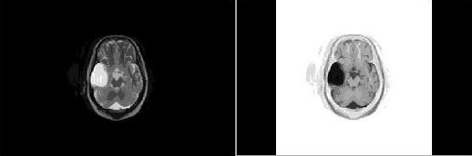
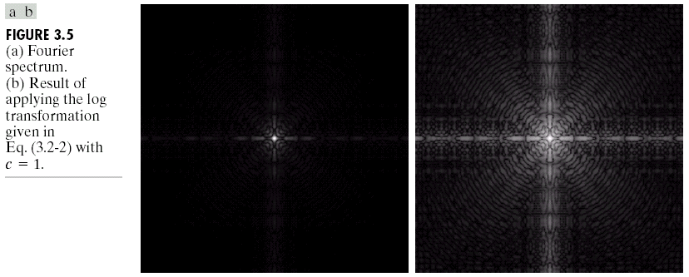
Image Operations
Negative
Log

Slide 11
Sources of Images
Electromagnetic (EM) energy spectrum
Acoustic
Ultrasonic
Electronic
Synthetic images produced by computer

Slide 12
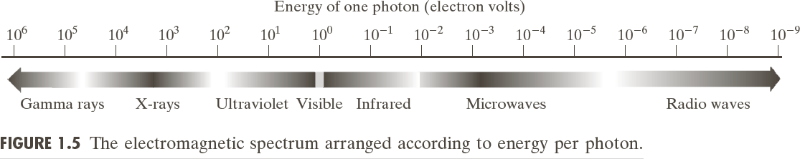
Electromagnetic (EM) Energy Spectrum
Major uses
  Gamma-ray imaging: nuclear medicine and astronomical observations
  X-rays: medical diagnostics, industry, and astronomy, etc.
  Ultraviolet: lithography, industrial inspection, microscopy, lasers, biological imaging and astronomical observations
  Visible and infrared bands: light microscopy, astronomy, remote sensing, industry,
and law enforcement
  Microwave band: radar
  Radio band: medicine (such as MRI) and astronomy

Slide 13
Introduction
Why we need image processing?
It is motivated by three major applications-
Improvement of pictorial information for human perception.
Image processing for autonomous machine application.
Efficient storage and transmission.

Slide 14
Human Perception
Employ methods capable of enhancing pictorial information for human interpretation and analysis
  Typical applications:
  Noise filtering
  Content enhancement
    Contrast enhancement
    Deblurring
    Remote Sensing
    Archeology, Astronomy, Biology, Medical Imaging, Space program etc.

Slide 15
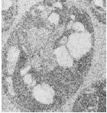
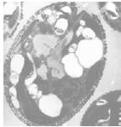
Filtering
Image of a cell corrupted by electronic noise
Result after filtering

Slide 16
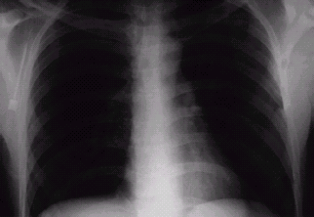
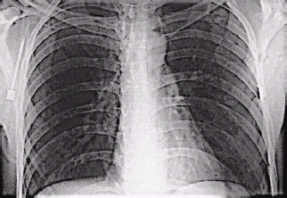
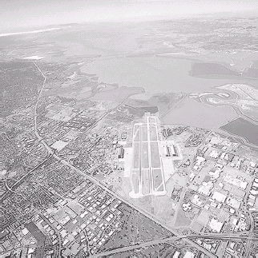
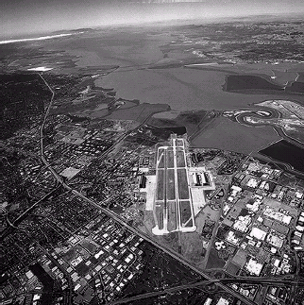
Image Enhancement
An X-Ray image
An aerial image

Slide 17
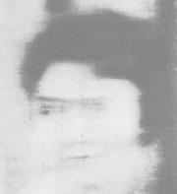
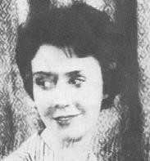
Image Deblurring
Image of a human face blurred by uniform motion during exposure
Resulting image after application of a deblurring algorithm

Slide 18
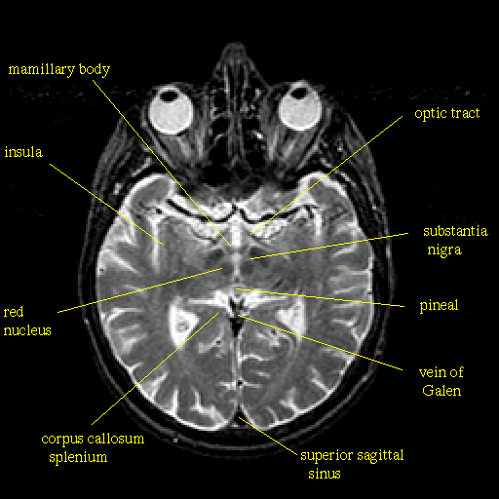
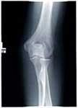
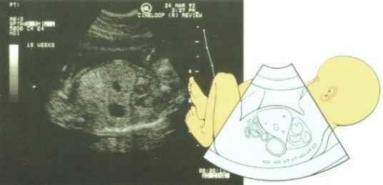
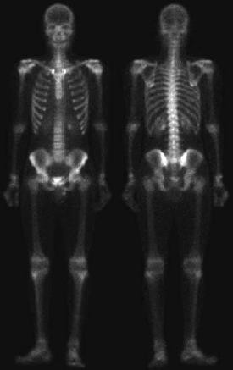
Medical Imaging
MRI of normal brain
Knee X-Ray
Ultrasound of 5 months foetus
Bone scan (Gamma ray imaging)

Slide 19
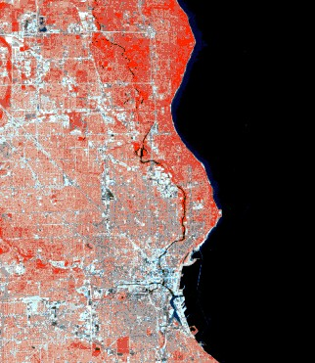
Remote Sensing
Satellite image (Kolkata)

Slide 20
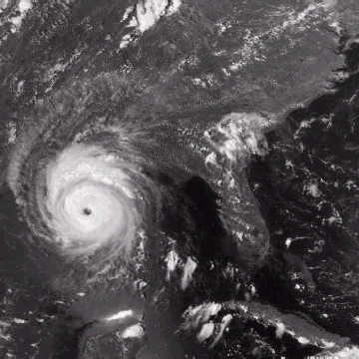
Weather Forecasting
Multispectral image of a hurricane

Slide 21
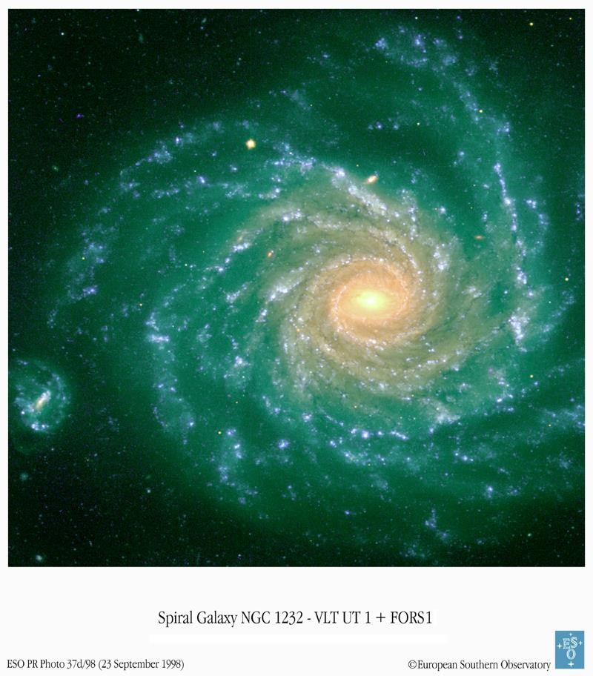
Astronomy
Galaxy

Slide 22
Machine Perception
Here the interest is on procedures for extraction of image information suitable for computer processing
  Typical applications:
    Automatic Optical Character Recognition
    Industrial machine vision for product assembly and
  inspection
    Automatic fingerprint recognition
    Automatic target detection and tracking
    Machine processing for satellite imagery for weather prediction and crop assessment.

Slide 23
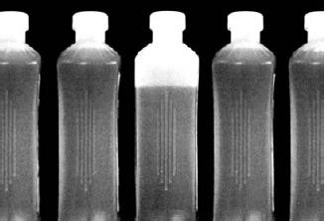
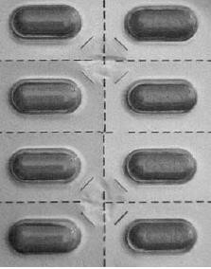
Automated Inspection
Bottling plant automation Packaged pills

Slide 24
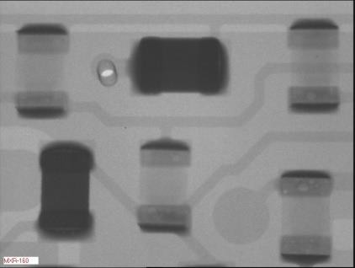
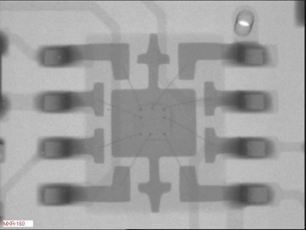
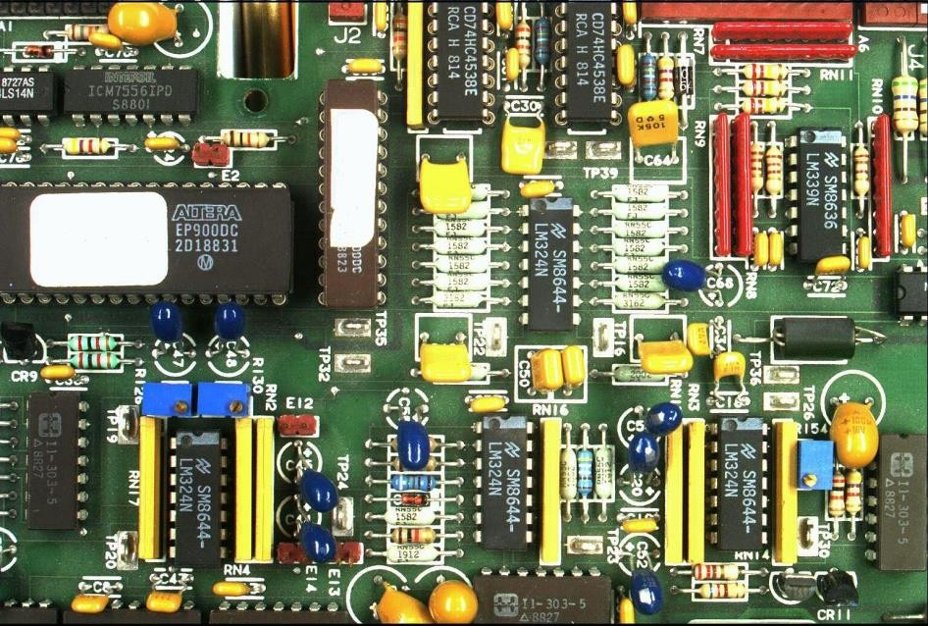
Automated Inspection
PCB inspection

Slide 25
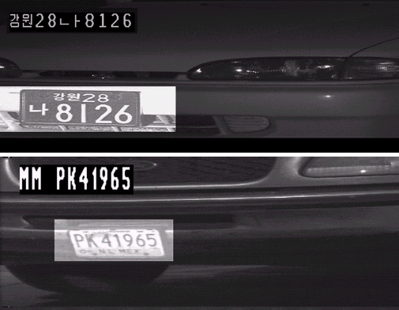
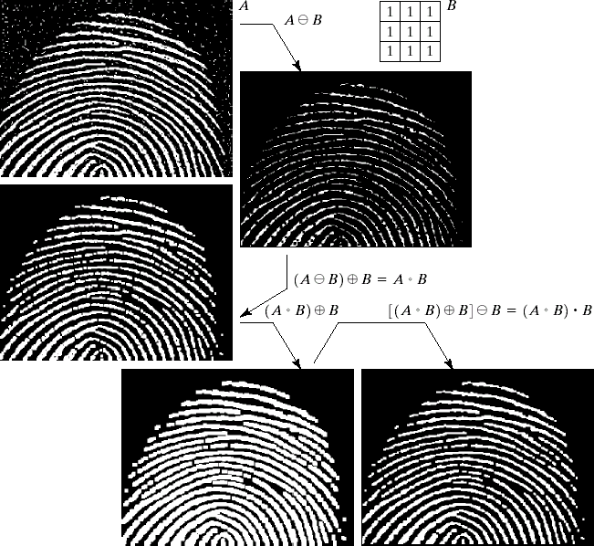

Law Enforcement
License plate recognition Finger print recognition
Signature Verification

Slide 26
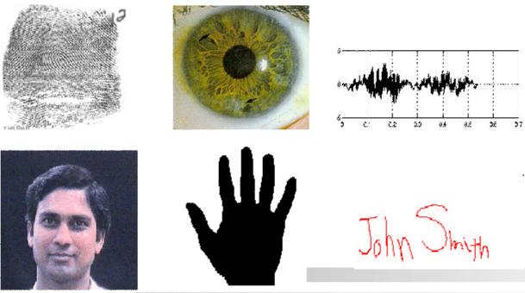
Biometrics

Slide 27

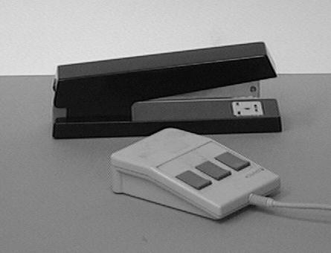
Object Recognition

Slide 28
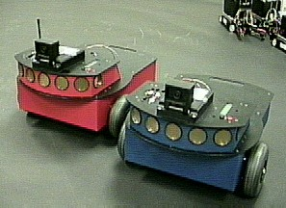
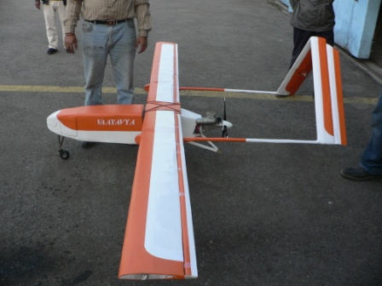
Autonomous Vehicles
Land, Underwater, Space

Slide 29
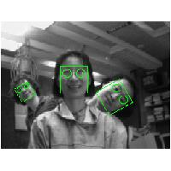
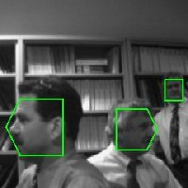
Face Detection

Slide 30
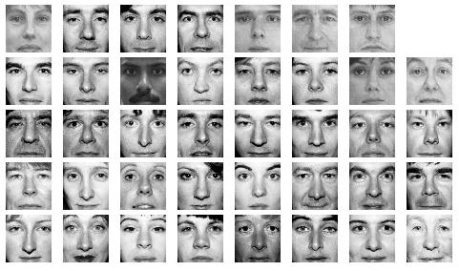
Face Recognition

Slide 31

Hand Gesture Recognition
Smart Human-Computer User Interfaces
Sign Language Recognition

Slide 32
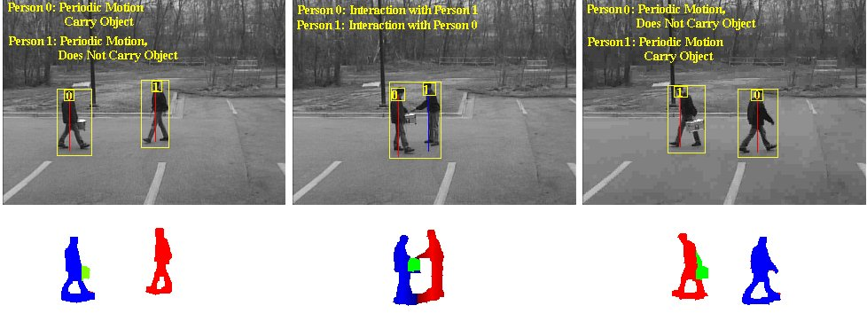
Activity Recognition

Slide 33
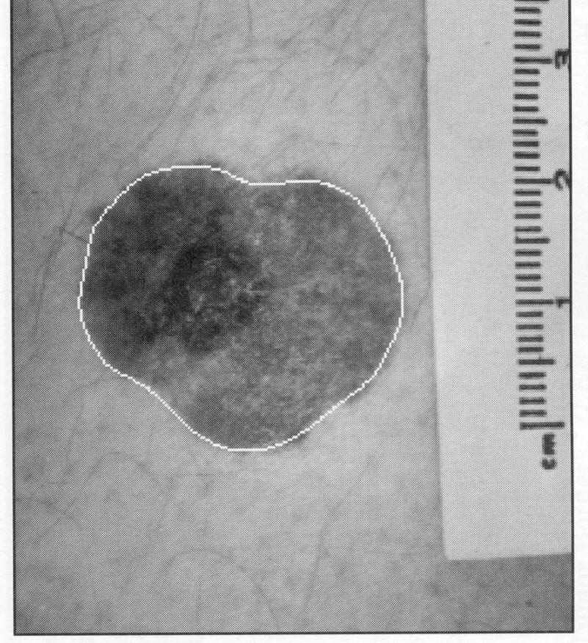
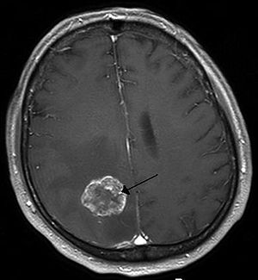
Medical Applications
Skin Cancer
Brain Tumour

Slide 34
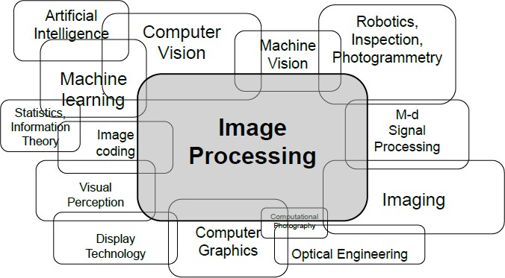
Connections to other disciplines

Slide 35
Connections to other disciplines
The continuum from image processing to other disciplines can be broken up into low, mid- and high-level processes
Low Level Process
Mid Level Process
High Level Process
Input: Image
Output: Image
Examples: Noise removal, image sharpening
Input: Image
Output: Attributes
Examples: Object
recognition, segmentation
Input: Attributes
Output: Understanding
Examples: Scene understanding, autonomous navigation

Slide 36

Fundamental Steps in Digital Image Processing
Segmentation
Representation
and Description
Preprocessing
Knowledge Base
Recognition and Interpretation
O/P
Outside world
Image
Acquisition
The Digital Image Processing System
The DIP system takes inputs from the outside world and produces desirable
(application dependent) outputs.

Slide 37
Step 1: Image Sensing and Acquisition
Two elements are required to acquire a digital image:
  A physical device that is sensitive to a band in the electromagnetic spectrum (X-ray, Ultra Violet, Visible, Infrared) to produce an electrical signal proportional to the level of energy sensed (i.e. sensors or detectors)
  A digitizer to convert this signal into digital form.
NOTE: There are sensors available that directly give digital output.

Slide 38
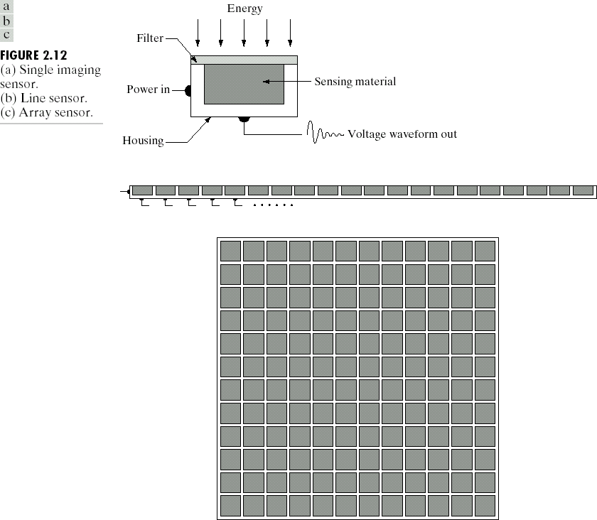
Step 1: Image Sensing and Acquisition

Slide 39
Step 2: Image Preprocessing
Enhances the image quality
For example
    Enhancing contrast
    Removing noise
    Isolating regions of interest (ROI).

Slide 40
Step 3: Segmentation
It partitions an input image into its constituent parts or objects.
NOTE:
  Autonomous segmentation is one of the most difficult tasks in digital image processing.
  Good segmentation ensures ease in achieving successful solution to an imaging problem.
  Bad segmentation guarantees eventual failure to an imaging problem.

Slide 41
Step 4: Representation and Description
Representation implies conversion of the data to a form suitable for computer processing e.g. boundary representation or complete region representation.
Description (or feature selection) deals with extracting features that result in some quantitative information of interest or features that can differentiate one class of objects from another.

Slide 42
Step 5: Recognition and Interpretation
Recognition implies assigning of a label to an object based on information provided by its descriptors.
Interpretation implies assigning of a meaning to an ensemble of recognized objects

Slide 43
Image Knowledgebase
The knowledgebase stores the prior knowledge about the outside world (the problem domain).
The processing modules interact with the knowledge base to aid in the processing.

Slide 44
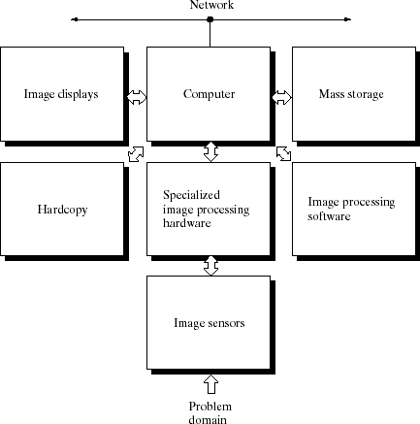
Components of Image Processing System

Slide 45
Components of Image Processing System
Image acquisition
  Scanners, video camera, CCD cameras, digitizers, etc.
Storage
  Short term storage, on-line storage and archival storage
Processing
  Small personal computers to dedicated processing hardware.
Communication
  Local communication between the processing systems
  Remote communication for transmission of images
Display
  Monochrome Monitors to sophisticated display devices

